Slide 1

COM-Based Transformer

Slide 2
MOHAMED NASSER ALI
1804727

Slide 3
Introduction
The COM Based Transformer is a feature of AUTOSAR that enables data transformation between the RTE and the communication stack.
It allows the use of arbitrary transformers to linearize and transform data according to a fixed communication matrix.
The COM Based Transformer does not support Client-Server communication.
The COM Based Transformer does not support external trigger communication.
The COM Based Transformer does not support Sender-Reciever communication.

Slide 4
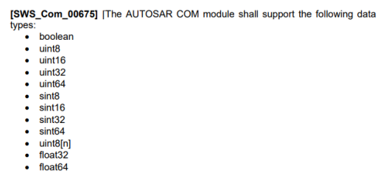
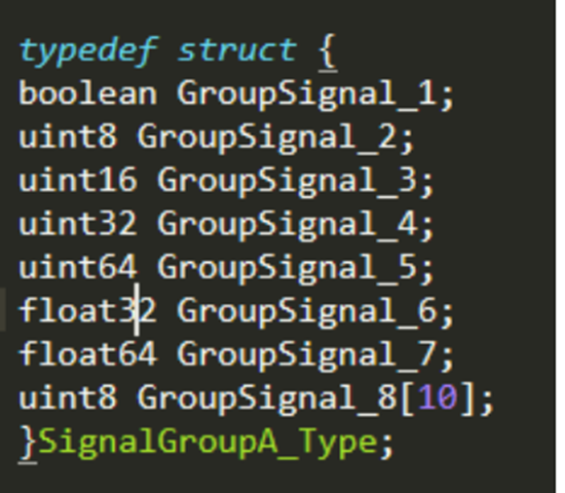
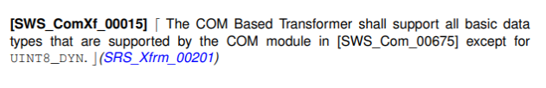
data TYPES
The data element shall be wrapped in a structure.

Slide 5
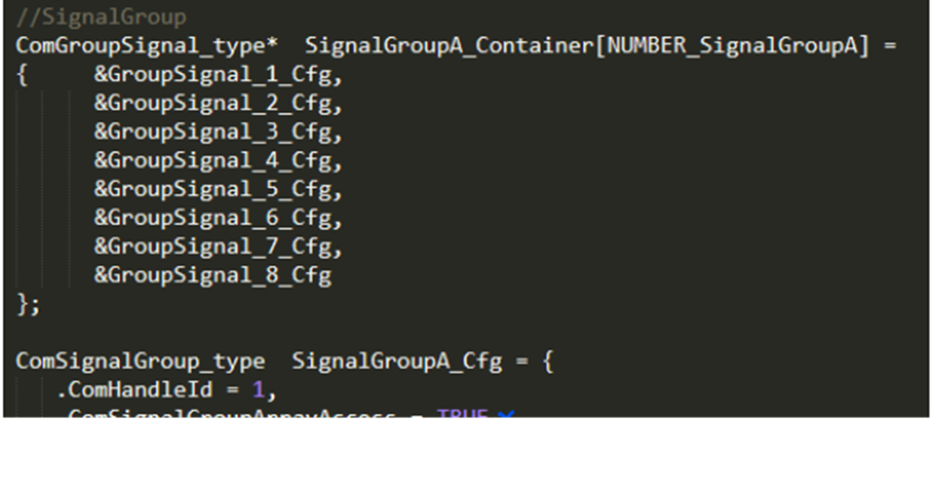
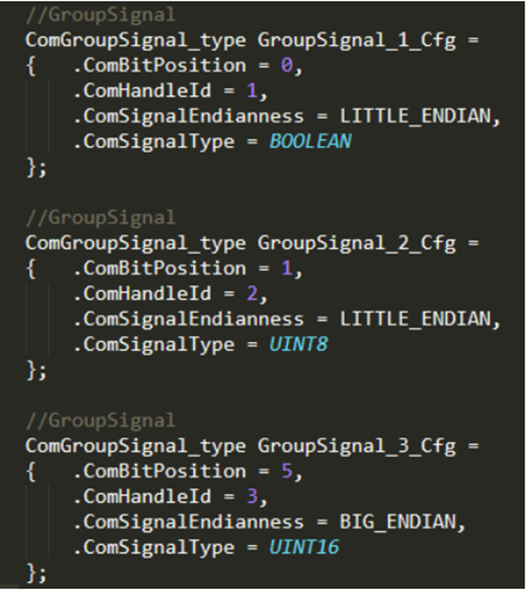
data TYPES (CONT.)
SignalGroup
The COM Based Transformer only supports signal groups.
GroupSignal

Slide 6
APIs
MOHAMED NASSER ALI 1804727
ComXf_Init
ComXf_DeInit
ComXf_<transformerId>
ComXf_Inv_<transformerId>
ComXf_GetVersionInfo

Slide 7
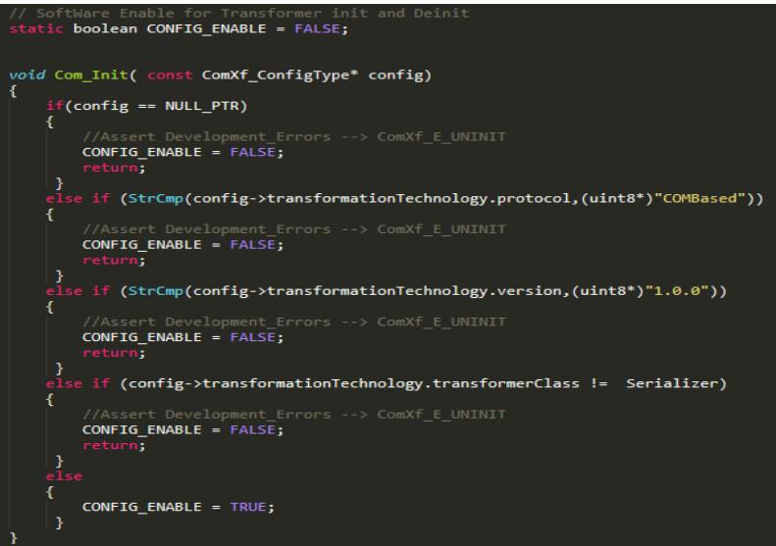
ComXf_Init
This service initializes the transformer for further processing.

Slide 8
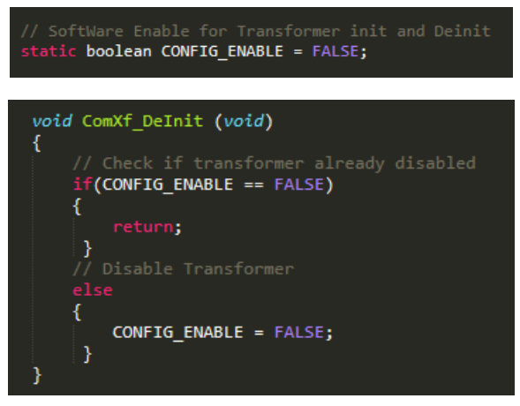
ComXf_DeInit:
This service deinitializes the transformer.

Slide 9
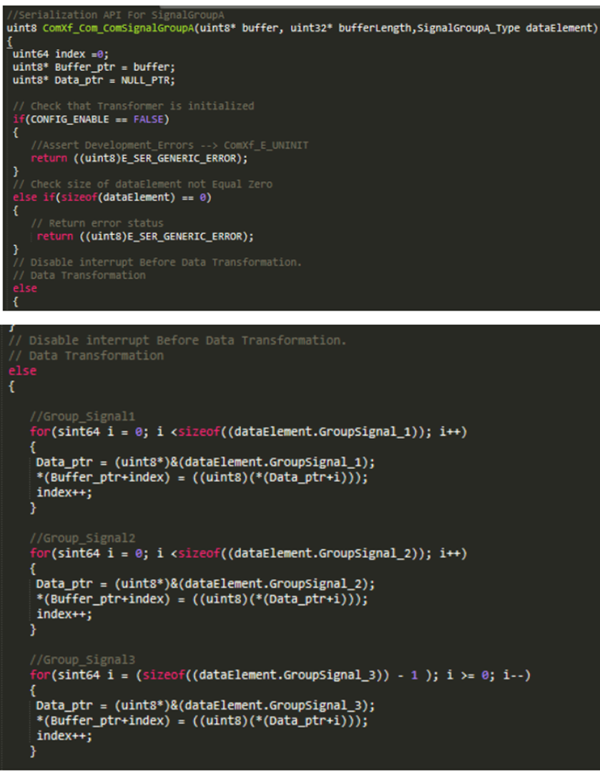
ComXf_<transformerId>
This function transforms a Sender/Receiver communication using the serialization of COM Based Transformer.
It takes the data element as input and outputs a uint8 array containing the serialized data.
This function takes Care about Endianness and Bit Position Configuration.

Slide 10
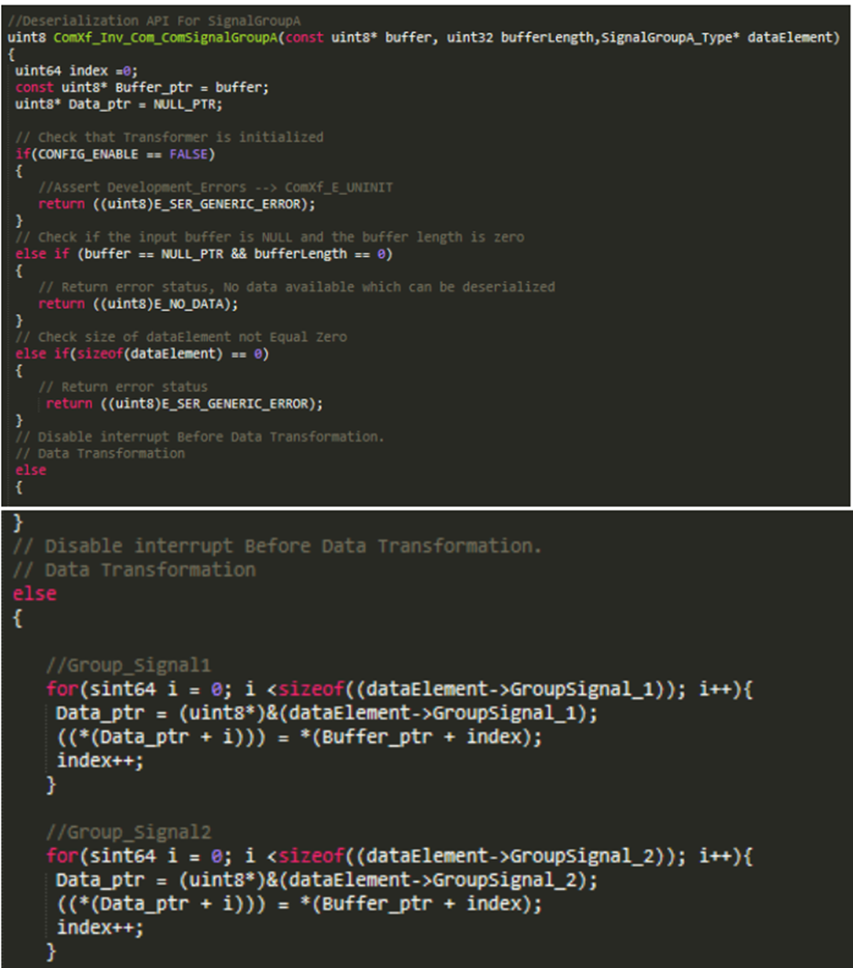
ComXf_Inv_<transformerId>
This function deserializes a Sender/Receiver communication using the deserialization of COM Based Transformer.
It takes the uint8 array containing the serialized data as input and outputs the original data element which will be passed to the Rte.
This function takes Care about Endianness and Bit Position Configuration.

Slide 11
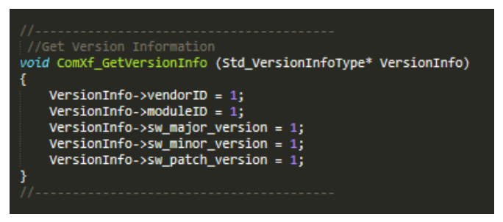
ComXf_GetVersionInfo
This service returns the version information of the called transformer module.

Slide 12
COM – BASED ENHANCEMENT on GPU

Slide 13
Mohamed Reda Ismail
1804229

Slide 14
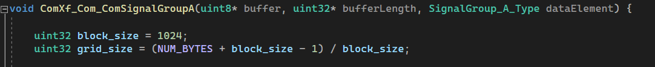
Serialization API
Grid
Number of threads
Why not maximize it?
Block 0
Block 1
Block 2
Block 3

Slide 15
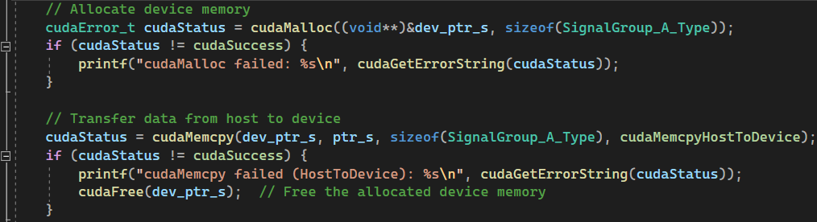
Serialization API(CONT.)
dev_ptr_s
SignalGroup_A_Type size
Device memory allocation
Transfer signal group from host memory to device memory
SignalGroup Data
GPU Memory

Slide 16
Serialization API (cont.)
Signals Offsets initialization and transfer to GPU memory
start
end
start
end
start
Size of signal 1 + Size of signal 2
Size of signal 1 + Size of signal 2
0
Size of signal 1
Size of signal 1
Signals offsets array
Signal 1
Signal 2

Slide 17
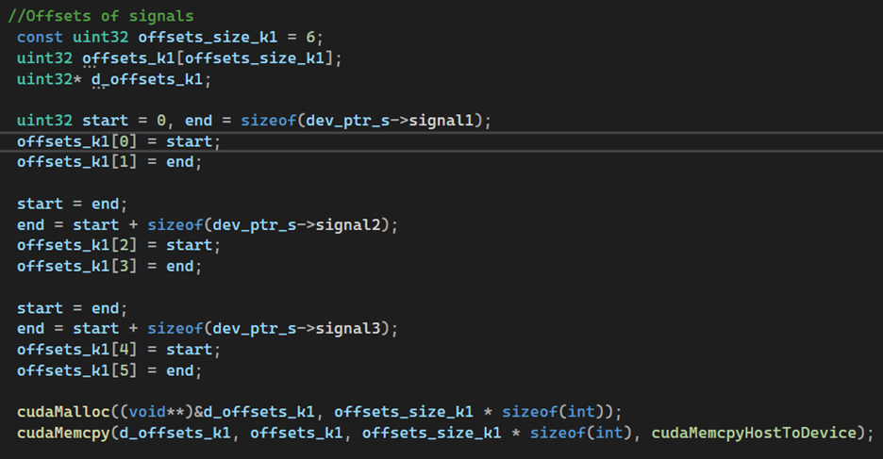
Serialization API (cont.)

Slide 18
Serialization kernel (The Global function)
Kernel call
Thread ID
How does the kernel work?
SignalGroup_Type_A
A
B
C
D
E
F
G
H
I
J
K
L
M
N
O
P
Q
T
Threads work in parallel
Buffer
A
B
C
D
E
F
G
H
I
J
K
L
M
N
O
P
Q
T

Slide 19
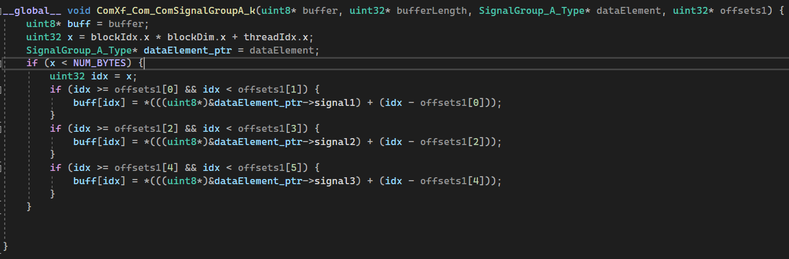
Serialization kernel (The Global function) (CONT.)

Slide 20
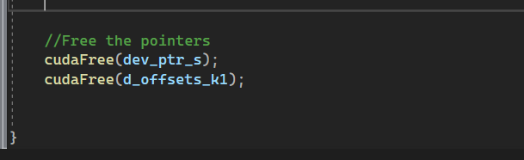
Serialization API (cont.)
dev_ptr_s
Free GPU memory
d_offsets_k1
GPU Memory

Slide 21
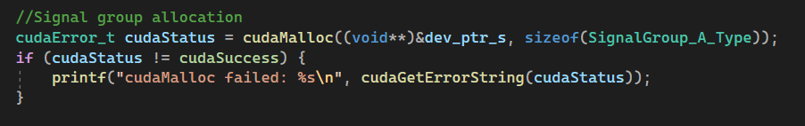
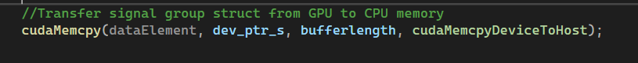
DESERIALIZATION API
Signal group allocation
Transfer signal group from GPU to CPU memory

Slide 22
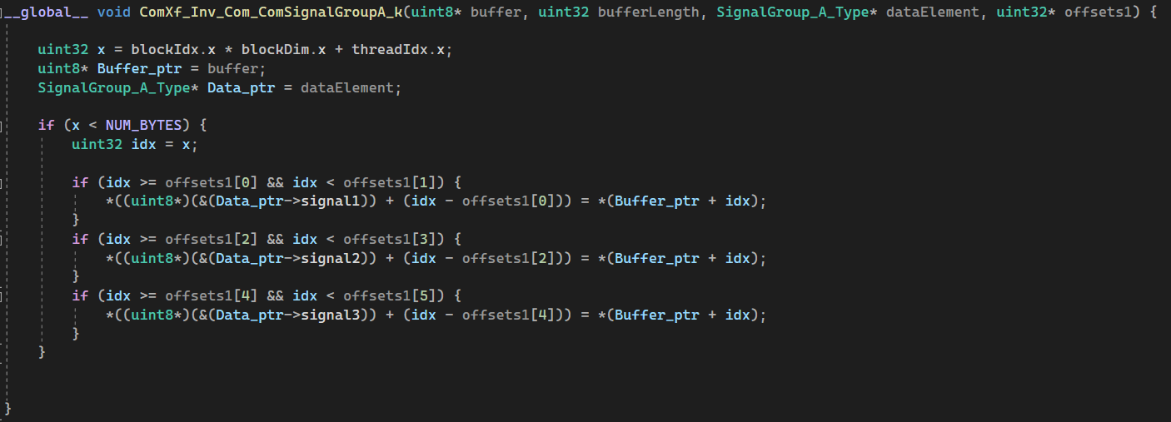
DESERIALIZATION API (CONT.)

Slide 23
DESERIALIZATION API (CONT.)
Buffer
A
B
C
D
E
F
G
H
I
J
K
L
M
N
O
P
Q
T
Threads work in parallel
SignalGroup_Type_A
A
B
C
D
E
F
G
H
I
J
K
L
M
N
O
P
Q
T

Slide 24
Ahmed Khaled Saad
1809799
COM-Based Enhancement Graphs

Slide 27
Wraps
SM 1
SM 2
SM 3
SM 4
27

Slide 31
Special THANKs to
Prof. Mohamed Taher,
Dr. Ahmed Moro (Siemens EDA).
Eng. Hossam Mahmoud: Siemens.
Eng. Mohamed Alansary: Siemens.
Eng. Khaled Ahmed : Siemens.

